Slide 1
Chative
-make you talkative

Slide 2
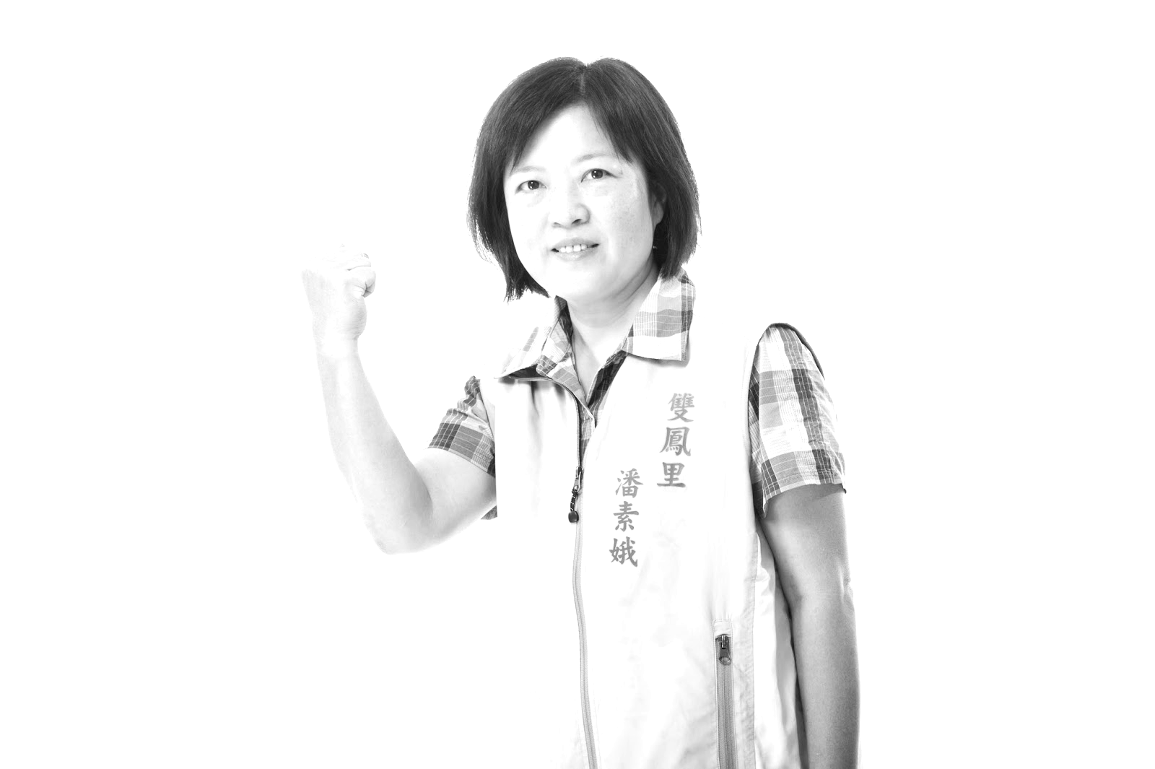
Background
在這個資訊爆炸的時代，交友聊天軟體如雨後春筍般冒出，廣大的鐵漢帶著柔情似水的心加入聊天室。但往往容易因為不知道要聊甚麼，或接甚麼，而卻步。最後，他們紛紛退出這場戰役，交友市場也因而漸漸萎靡，這對台灣軟體業十分不健康。
因此本計畫試圖利用聊天輔助系統，提供使用者回復選項，藉此創造良好的聊天氛圍，增加使用者自信，共創雙贏局面。

Slide 3
DEMO

Slide 4
什麼是好的聊天

Slide 5
．Model
．Backend
．Extension
How we made it.

Slide 6
Model - Data preprocessing
Remove messages in duplicate.
Extract “good” messages.
Generate training data.

Slide 7
-Remove messages in duplicate
Since we can only chat with people with opposite sex.
So we can achieve this goal by selecting files owned by male or female.

Slide 8
-Extract good messages
Extract the interval which messages are frequently sent by users.
If the average cycle sending each message is at least c during a duration d, keep the interval.

Slide 9
-Generate training data
Calculate the time left from each message to the end of current interval.
Calculate the number of messages left from each message to the end of current interval.

Slide 10
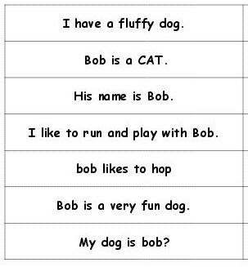
Model - Trainning
Used chatting data to train the Word2Vec model
Embedded the sentence to 100 dimension vector
Built similarity matrix based on Consine Similarity
Cosine Similarity
Input query
Give the similarity weight between query sentence and corpus sentence
Sort it!

Slide 11
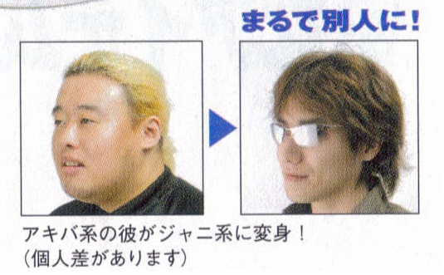
Model - Evaluation

Slide 12
Backend - Server
Django
RESTful API by the djangorestframework package

Slide 13
Extention
Frontend Structure - Html, React, Redux.
Call Api ( Django Server )
Response

